Slide 1
City planning service -
Tallinn Planning Register
Changing the residents’ experience in engaging with the planning information and giving feedback about city planning

Slide 2
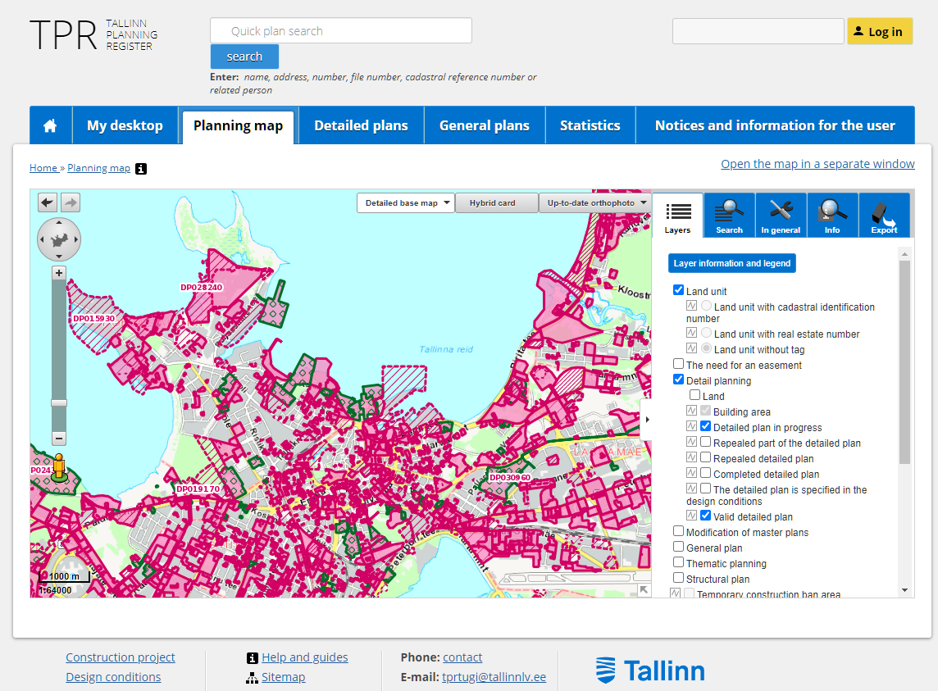
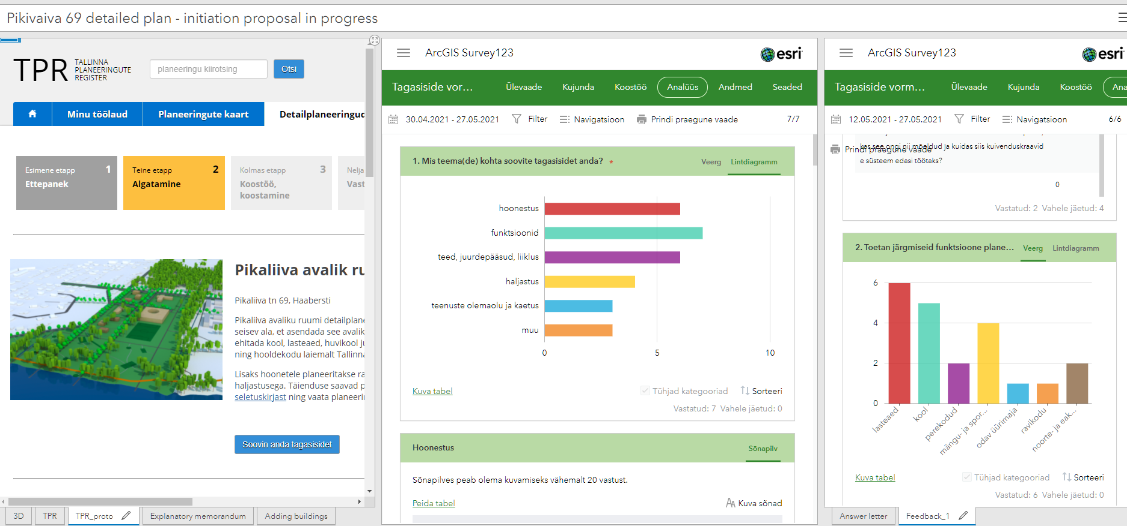
City planning service
Service has three main parts:
-sharing the right and resident focused planning information
-collecting and analyzing resident feedback data
-using feedback data to improve decision making
Changing how residents interact with the city regarding city planning

Slide 3
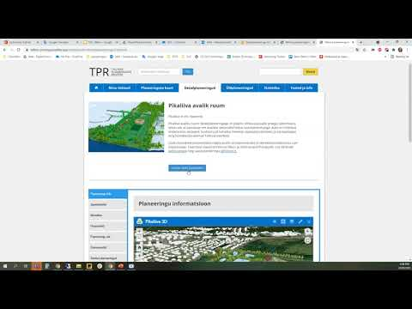

Slide 4
Vision for the city planning service
The development of the Tallinn Planning Register is only one part of improving the service.
Proactive engagement
Accessible planning register
Efficient and effective use of feedback
Better communication
Asking for feedback earlier
Clearly showing which details city needs feedback about and how to do it
Better analysis of resident feedback
Better answering commonly asked questions
Engaging a more representative group of residents
Clearly demonstrate how planning decisions link to the city planning strategy
Making decisions informed by balanced feedback and strategy
Showing how feedback affects planning
Clearly communicating the Tallinn 2035 vision
Content about plans is understandable, reducing need for clarifying questions
Clearly responding to all resident feedback

Slide 5
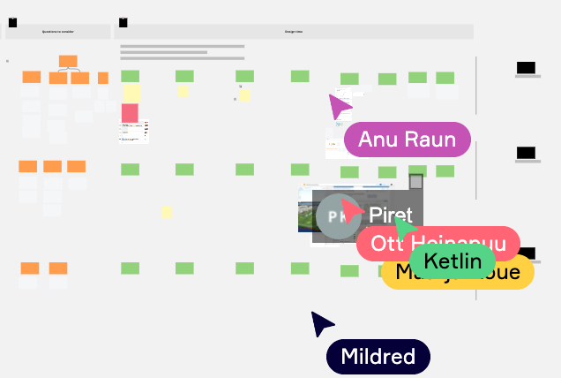
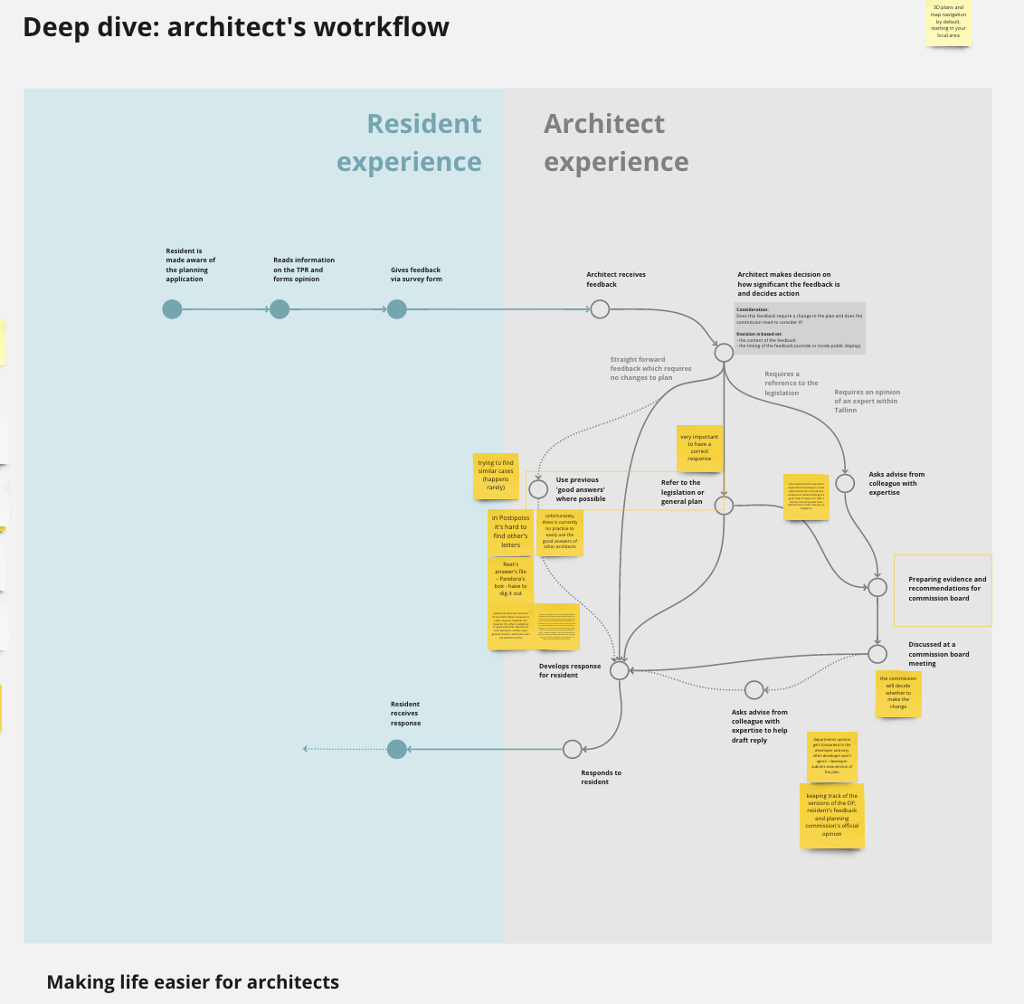
User-centricity principles
Digital Delivery
-planning data is made more accessible digitally
Accessibility, usability
-testing
-clear content
Reduction of the administrative burden
-processes made more efficient
-less residents contact the city
Citizen engagement
-developed with residents starting from the beginning
-feedback about developments + about register itself
Incentives for digital use

Slide 6
Thank you!
Maarja Kõue
GIS specialist in Tallinn Strategic Management Office
maarja.koue@tallinnlv.ee

