Slide 1
Digitale Balie Rotterdam: Digital Service Desk for citizens //User Centric//Personal//Accesible//hyper Agile
May 2021

Slide 2
Digitale Balie vs Tallinn
Bjorn Dirkse
Innovation Manager || Project Manager || Product Owner
B.Dirkse@Rotterdam.nl

Slide 3
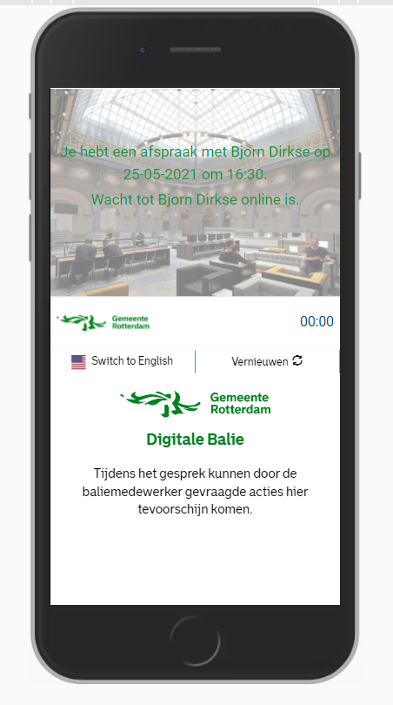
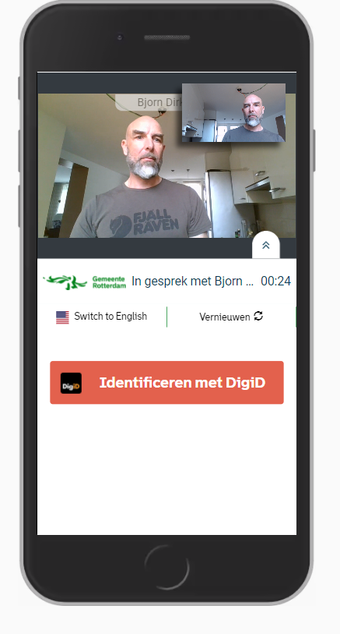
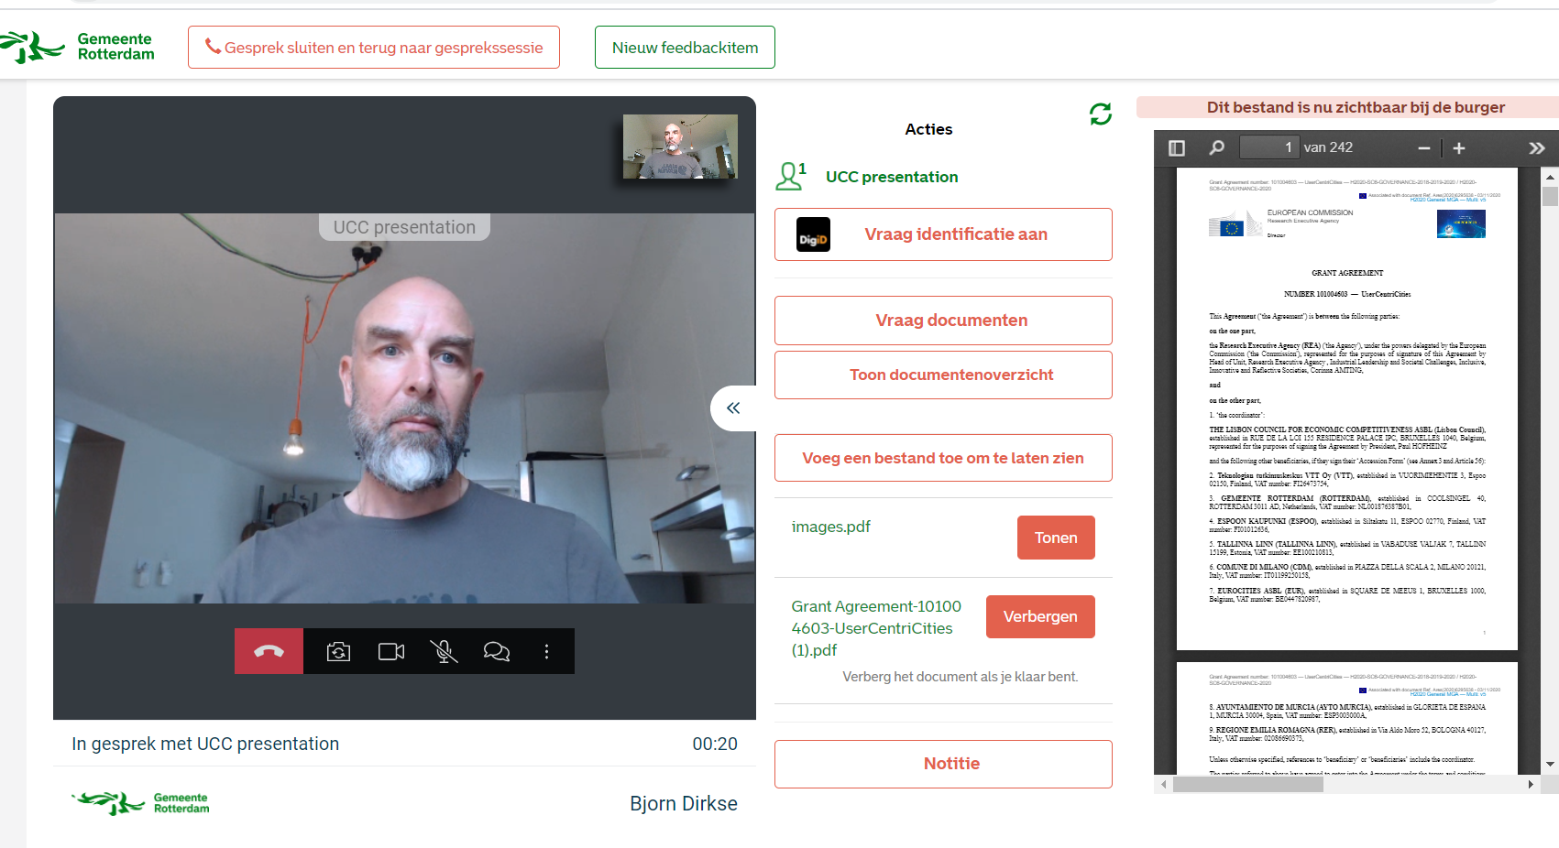
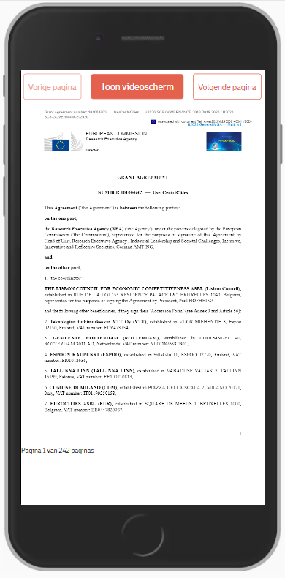
Digitale Balie vs Tallinn

Slide 4
Process
Started with “off the shelf video application
Requirements:
Safe
Easy and accessible
No installations/accounts required
Start with using!!
IN REAL LIFE
Gather feedback: CITIZEN & EMPLOYEE
First feedback:
Identification is key to delivering service
Appreciation=HIGH
Start devolping MVP=>back to 3

Slide 5
Accessibility
60-80% should be able to do business with us
“One Link Leads To All Action” principle
Employee leads citizen
UX/UI: comply to WCAG standards
Test, test, test, don’t asume
Digitale Balie Rotterdanm|UserCentriCities 26/05/2021

Slide 6
Reduction Administrative burden
Use of application leads to:
Higher “first time right”
Less “paper”
Higher flexibility in organizing business processes
Process stepts are logged: archive legislation compliant by design
Digitale Balie Rotterdanm|UserCentriCities 26/05/2021

Slide 7
Digital delivery
Hybrid service?
Face to face/offline still option!
Best of both worlds
“I experience a more personal connection then a real live visit to apply the birth of my child!”
~Rotterdam’ mother who just applied birth of a child through digital desk
Digitale Balie Rotterdanm|UserCentriCities 26/05/2021

Slide 8
Citizens engagement
Testing IRL
Feedback forms
SUS survey: ~88 (out of 100)
Digitale Balie Rotterdanm|UserCentriCities 26/05/2021

Slide 9
Citizens engagement
Testing IRL
Feedback forms
SUS survey: ~88 (out of 100)
Digitale Balie Rotterdanm|UserCentriCities 26/05/2021

Slide 10
System Useability Scale scores (March/April ’21).
Maart 2021.
System Usability Scale (SUS).
23 respondenten.
avg: 88,25
lowest: 62,5 (1x)
Highest: 100 (5x)
April 2021.
System Usability Scale (SUS).
47 respondenten.
Avg: 86,65
Lowest: 35 (1x)
Highest: 100 (9x)
88,25
86,65
Slecht
Matig
Goed
Uitstekend
Slecht
Matig
Goed
Uitstekend
0
51
68
80.3
100
0
51
68
80.3
100

Slide 11
Incentive 4 digital
High first time right
Service from the sofa
Almost as much fun as Netflix
Digitale Balie Rotterdanm|UserCentriCities 26/05/2021

Slide 12
Thank you for your attention.

