Slide 1
Murcia, Spain
Good Practice Presentation
OCULTO.TV
26/05/2021
Notes:
To use this title animation slide with a new image simply 1) move the top semi-transparent shape to the side, 2) delete placeholder image, 3) click on the picture icon to add a new picture, 4) Move semi-transparent shape back to original position, 5) Update text on slide.

Slide 2
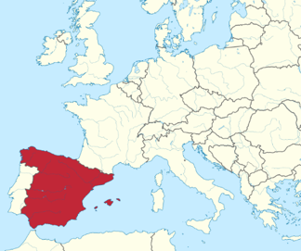
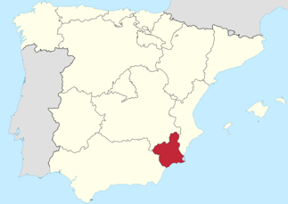
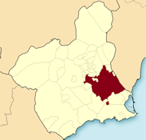
1
MURCIA
≈450K inhabitants
7th largest city of Spain
Capital of the Murcia Region
extensive municipality 881,86 km2
University City
Service based economy
Agriculture (exports)

Slide 3
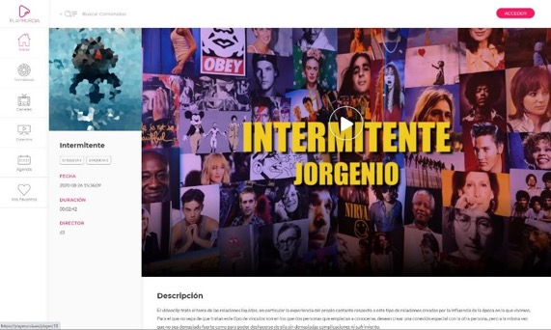
1
OCULTO.TV
COID-19
Local Culture and Cultural Heritage “consumption”
e.g.
The first audio-visual digital platform in Spain and Europe to showcase heritage and culture (for now)

Slide 4
1
OCULTO.TV
In development for six months
Intuitive
Visual
Modern
Accessible
Content compatible with physical programming of cultural spaces.
The platform will function as its own cultural centre but with a transversal character linking all existing spaces.

Slide 5
Digital Interaction The platform allows for interaction between users, between users and the municipality and even with creators/artists in specially programmed sessions. Accessibility, security, availability and usability The platform can be accessed by anyone, and anyone can submit content to be reviewed and included. Design principles were Intuitive, Visual, Modern & Accessible. Reduction of the administrative burden The service is as minimalistic as possible without losing functionality, directly servicing needs and rights regarding culture.
UCC Optimised Tallinn
Declaration

Slide 6
Citizen engagement OCULTO was developed with citizens (process), and has a continuous learning and improvement model. Additionally, suggestions can be made at any time. Open to use (as a creator/artist). Protection of personal data and privacy GDPR and national law compliant, privacy policy, secure personal profiles, no unnecessary data storage. Redress and complaint mechanisms Through the platform itself, direct contact.
UCC Optimised Tallinn
Declaration

Slide 7
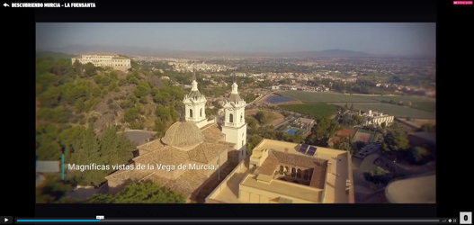
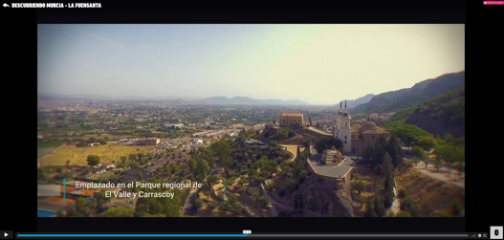
1
OCULTO.TV
First 3 months:
>15.000 Registered Users
>500.000 Reproductions of Content
>60 days (1440 hours) of Content Visualised
Views from 53 countries
700 “Items” on the platform,
350 awaiting review
20 Specific Channels crated
E.g.

Slide 8
Thank you!
www.usercentricities.eu
OCULTO.TV

