Slide 1
Regione Emilia-Romagna Comune di Bologna Nuova Rete Civica
1ST PROGRESS MEETING - 27/05/2021

Slide 2
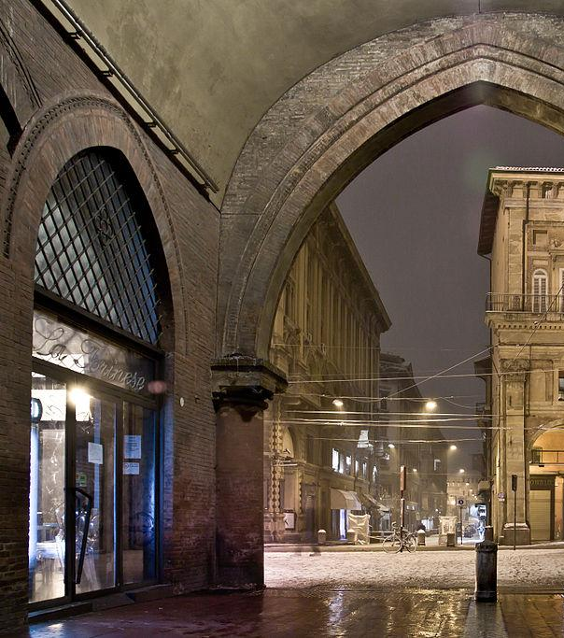
1
NUOVA RETE CIVICA
It will be the Digital Home of the Citizen, built upon her/his needs
Bologna + 28 smaller cities belonging to the metropolitan area (around 1M people).
Potentially all the municipalities of Regione Emilia-Romagna (328 - around 4.5M people)
Puscas Vadim (Nebbius), CC BY-SA 4.0, via Wikimedia Commons

Slide 3
Change of paradigm for the web platform
!
From a catalog of services and news to a useful tool that help the citizens to find answer to their needs:
“I want to find news and insights of general interest and I want to automatically receive those specific to my interests”
“I want to be helped to find the services I need and to discover opportunities that I do not know and that may be of interest to me”
“I want to interact with the offices in the way that is most convenient for me (in person or remotely) and receive support in using the services”
“I want to have a space where I can find my documents and my data and see the status of my applications”
“I want to participate (propose, be involved, be listened to) in the initiatives and projects of the entire community”

Slide 4
5 fundamental project guide lines
1
2
3
4
5
Focus on the user
redesign of the processes, fully digital, personalization and assistance;
Digital first
but taking care also of who needs the traditional channel (integration)
Integration with national public platforms
SPID, PagoPA, ANPR, App IO,...
Once only
interoperability with other public services, no need to ask users for the data she/he already gave
The service desk goes digital
Online bookings, video call, virtual assistant
Reference : The basics you can find anywhere 5 Steps To Successful Storytelling Published on April 5, 2014 Featured in: Marketing & Advertising

Slide 5
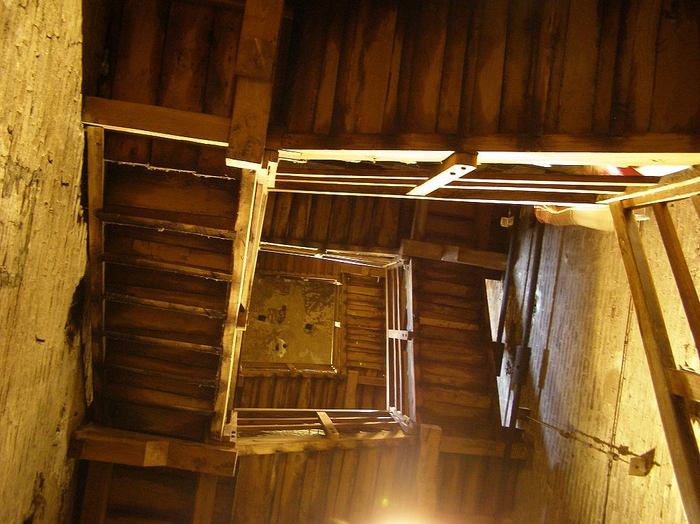
CUSTOMIZATION AND PROFILING
EASY TO FIND SERVICES, INFO, TOOLS
CLARITY
USABILITY AND ACCESSIBILITY
CROSS/MULTI CHANNEL
ECOSYSTEM
CITIZEN ENGAGEMENT
OPEN AND BIG DATA
Design principles
Andrzej Otrębski, CC BY-SA 4.0, via Wikimedia Commons
Notes:
Combine an image and multiple key statements with a strong grid.

Slide 6
Main components
Elenavanpelt, CC BY-SA 3.0 , via Wikimedia Commons
Online services
and personal data
CMS and Public website
Data and participation
CRM
Information management
News and events management
Instance management using Online modules
Personal Area divided in three sections: procedures, payment and documents
Data and Participation: participative processes management and data sharing with our territory
Improve the relationship with our citizens:
redress and complaint management
User’s desktop

Slide 7
Four phases (plus 1)
1
2
3
4
5
Discover citizens expectations
Services co-design workshops
Developing and testing cycles
Final test
Continuous check (and improving)

Slide 8
Open questionnaire (more than 1.000 answers):
why do you use the Municipality website
what are your expectations
Answers analysis with people in charge of online services and communication
Discover citizens
expectations

Slide 9
workshops to collect ideas and present proposals, with people representing possible users
use case analysis for specific contents
functional design and creation of wireframes / prototypes
users’ verification and collection of feedback both through scheduled sessions and through 'guerrilla tests'
Services co-design

Slide 10
Agile approach during the implementation phase
test sessions conducted with a stable group of users
Developing and
testing cycles

Slide 11
People with special needs or disabilities were involved during the assessment process
Task approach: content usability and objectives’ achievement
functioning of site’s elements: links, buttons, videos, etc.
Accessibility (WCAG 2.1 Guidelines): Perceivable (ease of access to content), Operable (ability to interact with content), Understandable (ability to make content clear and simple), Robust (ability to use accessible technologies)
Usability: Semantics (text, images, video), Interface (graphics, colors, animations), Navigability (structure, menus, help, indicators)
Feedback: OK / KO, violations / verifications, satisfaction
Final test &
continuous check - improving

Slide 12
Thank you!
giovanni.grazia@regione.emilia-romagna.it
www.regione.emilia-romagna.it

