Slide 1
The Australian Consumer Data Right: Standardising consumer experience
Barry Thomas, General Manager Data Standards Body
May 2021

Slide 2
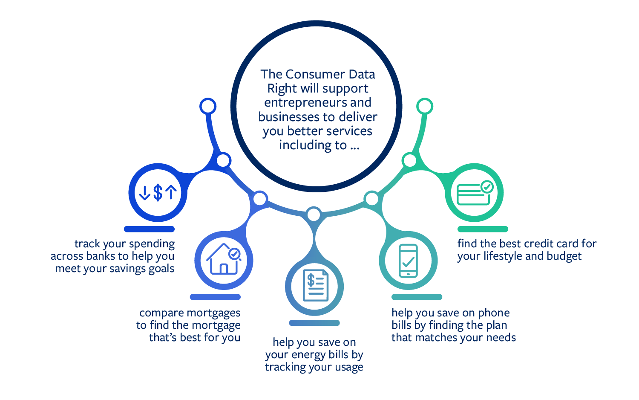
The ability to easily share electronic consumer data paves the way for new products and services. It also makes it easier for consumers to compare products, which could give them an incentive to switch providers. In turn, this encourages more competition in the marketplace and lower prices. Increased competition helps to drive the economy.
What is the Consumer Data Right?
“Australia’s new Consumer Data Right gives you the right to share your data between providers. If you choose to use Consumer Data Right, your information is transferred using automated data technology. The process has been designed to give you greater choice and control through the convenience of a simple, easy-to-use process.”

Slide 3
What are the Consumer Data Standards?
The Standards tell you how to meet the obligations imposed by the CDR Rules
Why do we need Consumer Data Standards?
Efficiency
Security
Consistency for consumers
What is the Data Standards Body?
Part of Treasury but answerable to the Data Standards Chair.
Three streams:
Community engagement and education
Technical (security and API’s)
Consumer Experience (“CX”)
How do the Consumer Data Standards work?
4 categories:
Information Security (”Infosec”)
Endpoints
Payloads (enhanced by “conventions”)
CX (enhanced by “guidelines”)
How are the Consumer Data Standards developed and managed?
In public, always
Highly structured processes
Iterative and constant change
Authority rests with the Data Standards Chair, advised by Advisory Committees

Slide 4
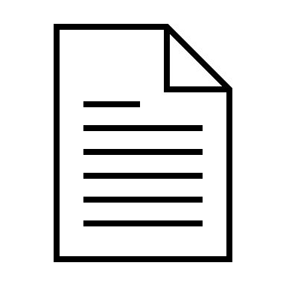
Data Standards Body Process
Public Domain
Propose
decisions
Workshop & Ideate
Makes the
Consumer Data Standards
Data Holders
Data Recipients
Data Standards Chair
Andrew Stevens
Decision Proposal/ Noting Paper
Advises the Chair
Community
feedback
Process
feedback
Data Standards Body

Slide 5
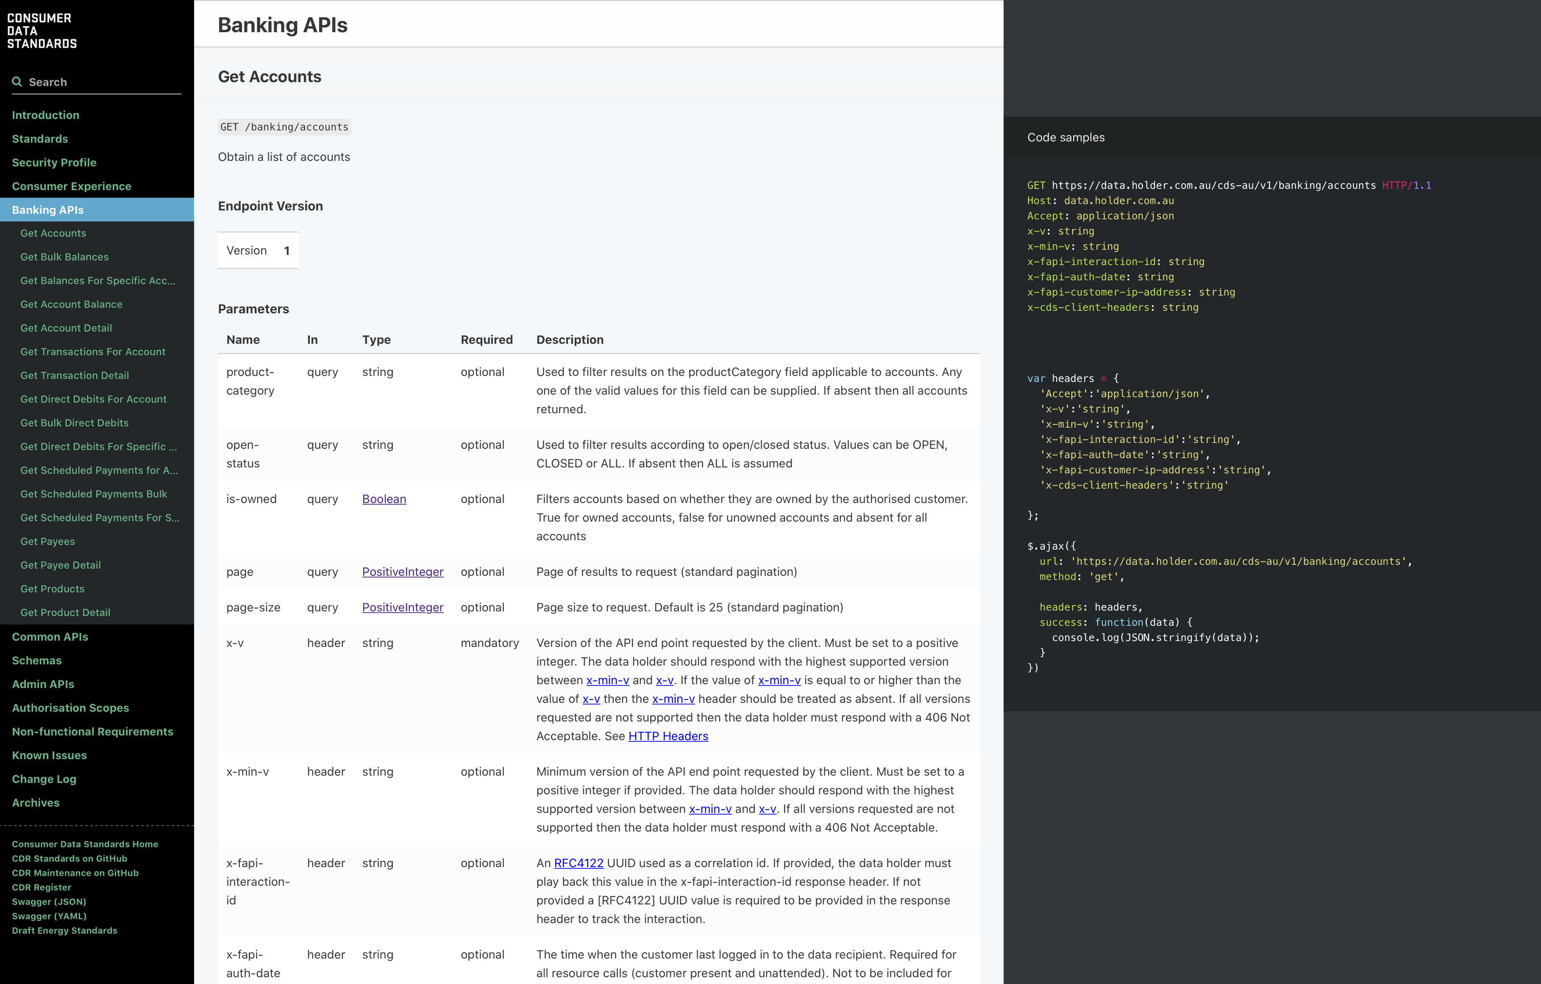
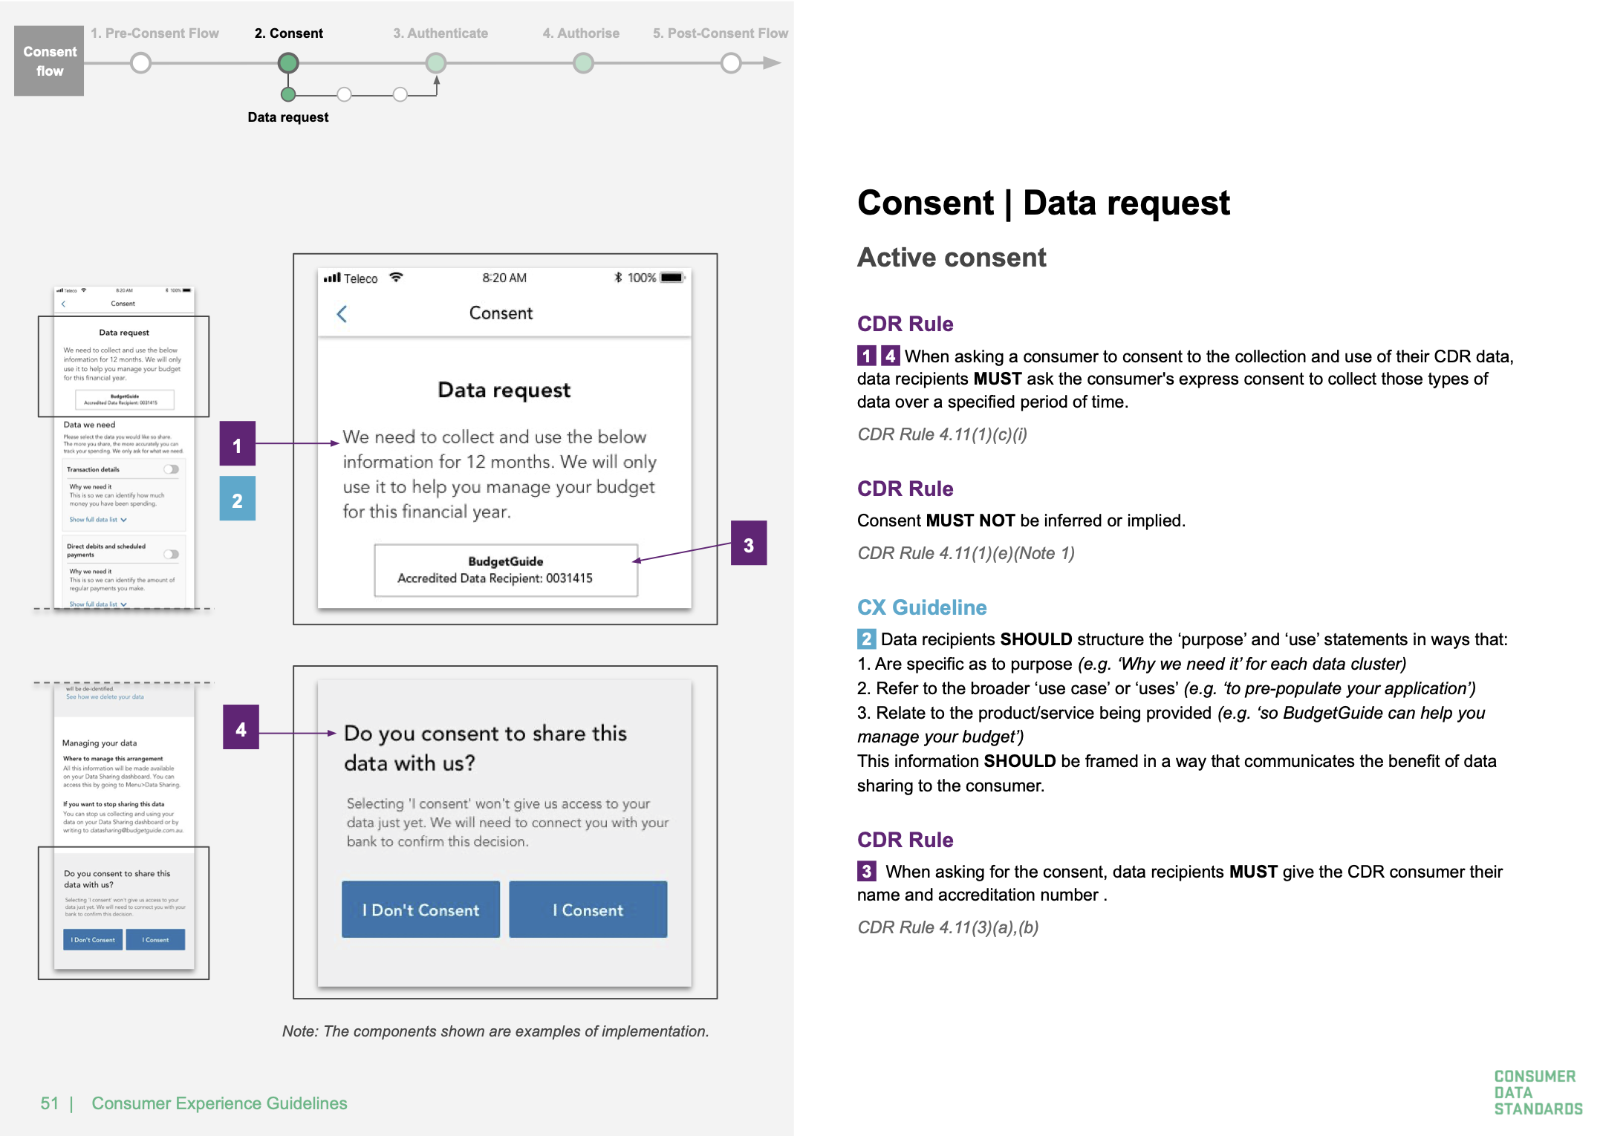

Slide 6
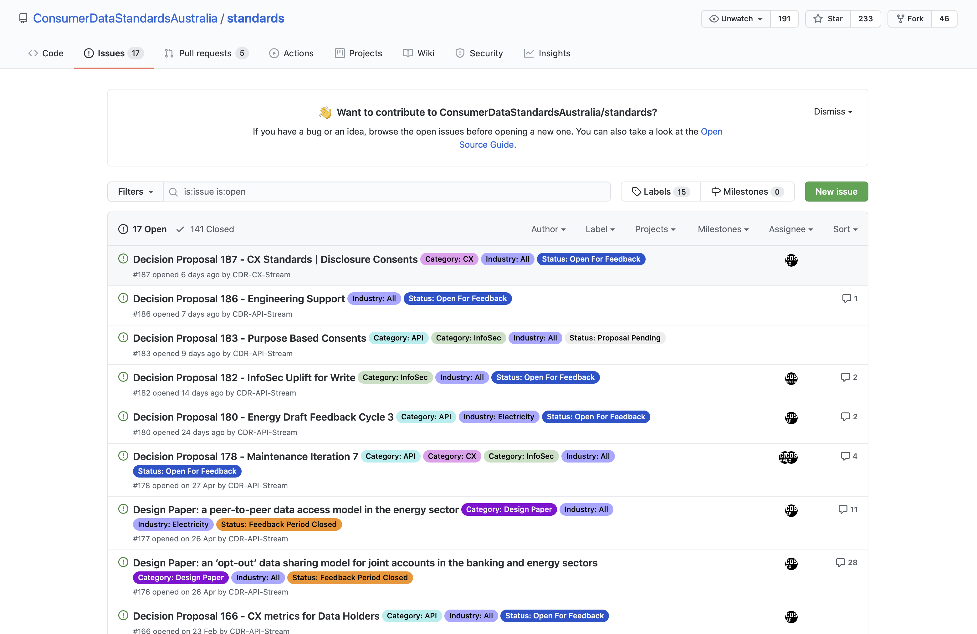

Slide 7
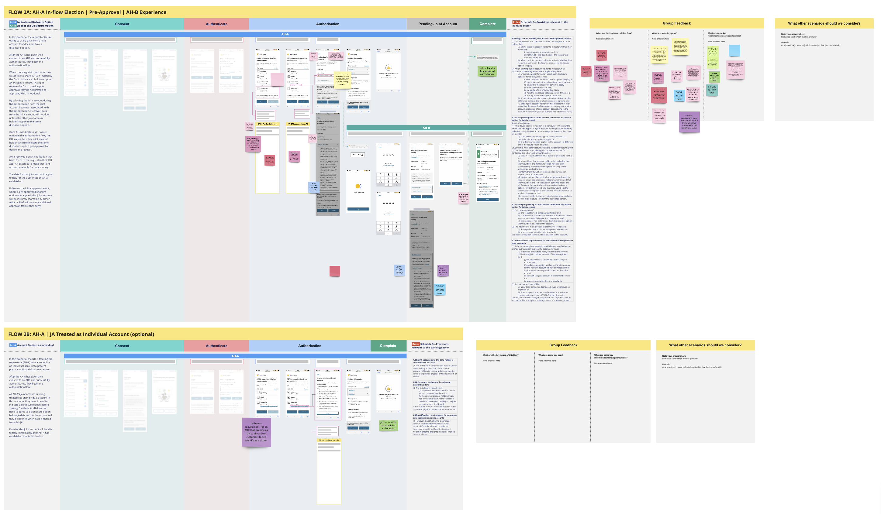

Slide 10
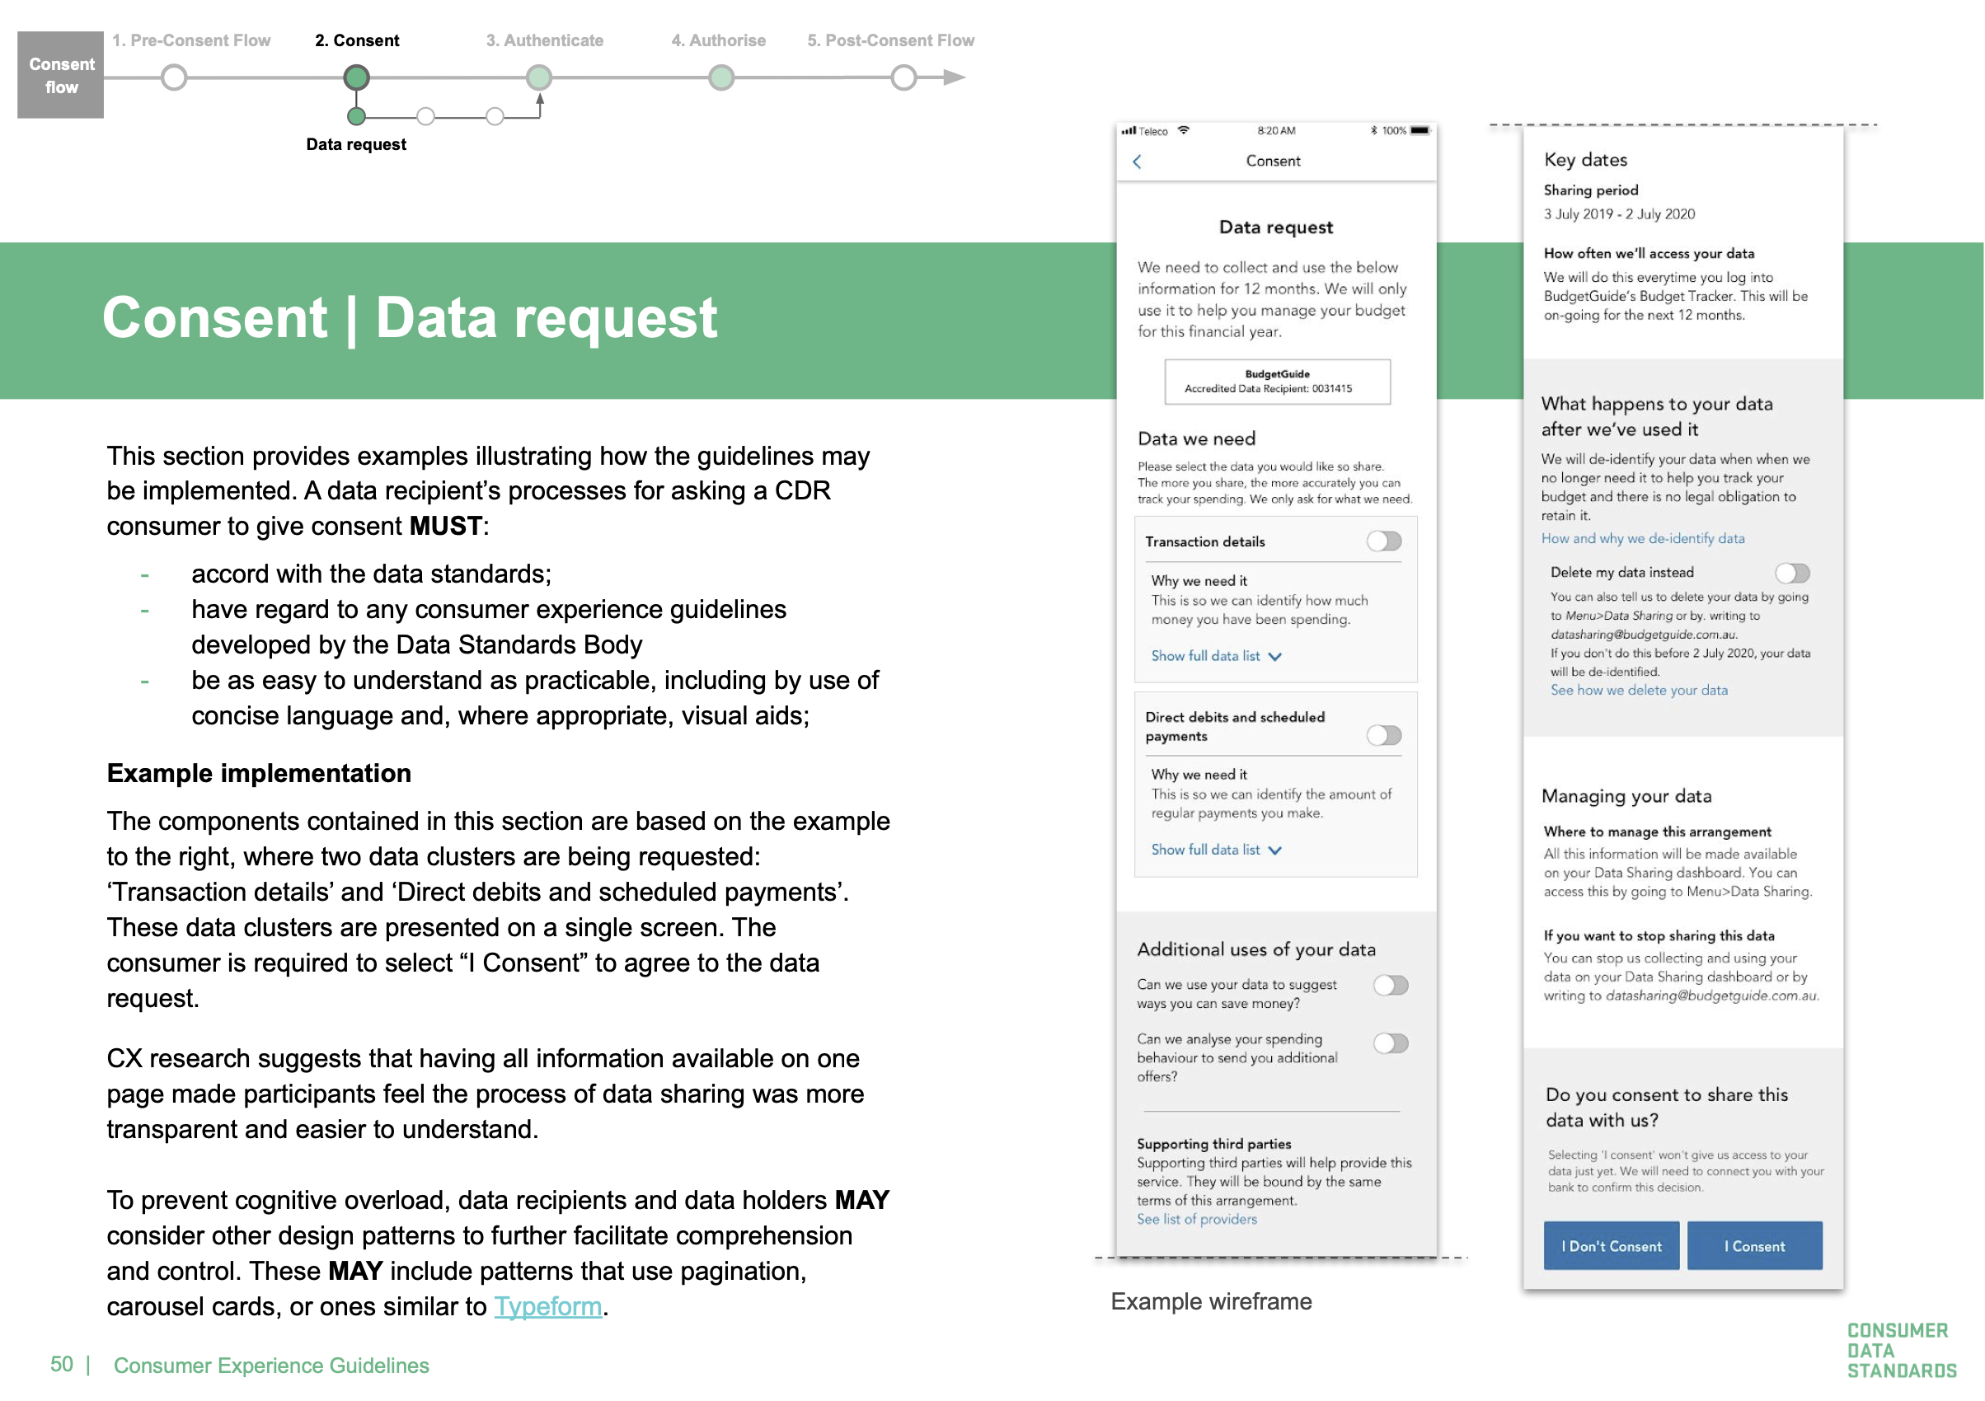

Slide 12
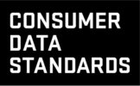
Dig deeper
Our resources
Useful links:
Data Standards Body website
The Consumer Data Standards
Consumer Experience Guidelines
Knowledge Base and community FAQ
Consumer Data Standards GitHub repository
Consumer Data Standards maintenance GitHub repository
GitHub Wiki
GitHub engineering artefacts
Java Artefacts
DSB Comparator demonstration
CX Research and reports
The Consumer
Data Standards
Consumer Data
Standards GitHub
public organisation
Data Standards
Body website

Slide 13
Thank you —

